Slide 1
Testing the “rusty sink” in freshwater sediment
Or “why has Abby spent so much time in Jeb’s lab this year”

Slide 2
Lakes and reservoirs are hotspots for global carbon processing
Notes:
Reservoirs, in particular, bury more carbon than ocean sediments each year.
At the same time, carbon emissions from reservoirs are 20% of global fossil fuel emissions

Slide 3
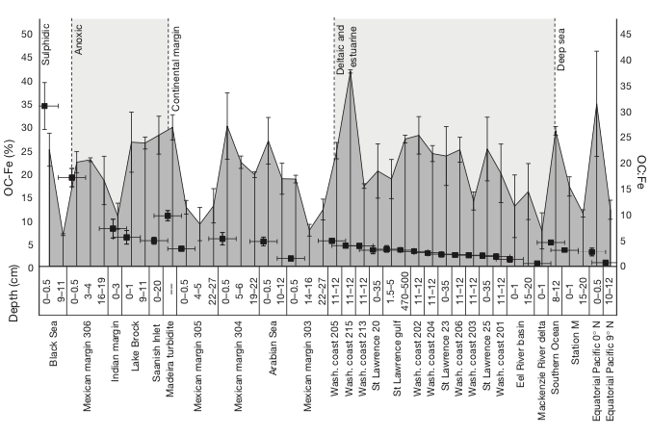
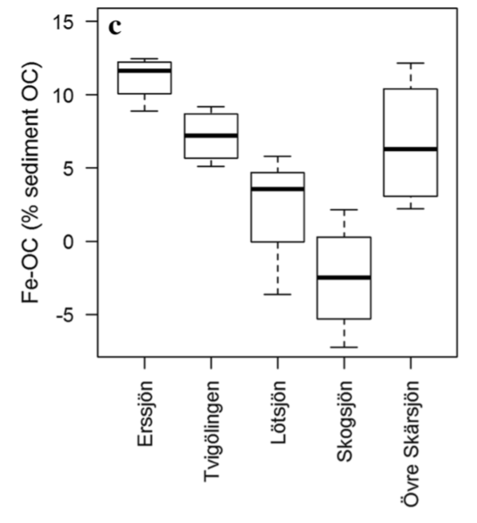
Fe plays a critical role in marine OC burial
The importance of Fe-OC in freshwater systems is unresolved
Brock Lake
µ = 27
µ = 23%
(Lalonde et al. 2012)
(Peter and Sobek, 2018)

Slide 4
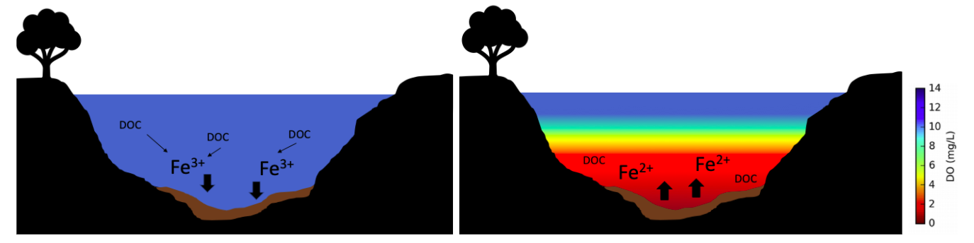
Oxygen concentrations are decreasing in lakes and reservoirs around the world
Decreased oxygen concentrations may cause reductive dissolution of Fe-OC complexes
Notes:
We know the anoxic panel is true. The oxic panel is a hypothesis

Slide 5
Does Fe-OC play a role in freshwater carbon burial?
How does anoxia impact Fe-OC in freshwater sediments?

Slide 6
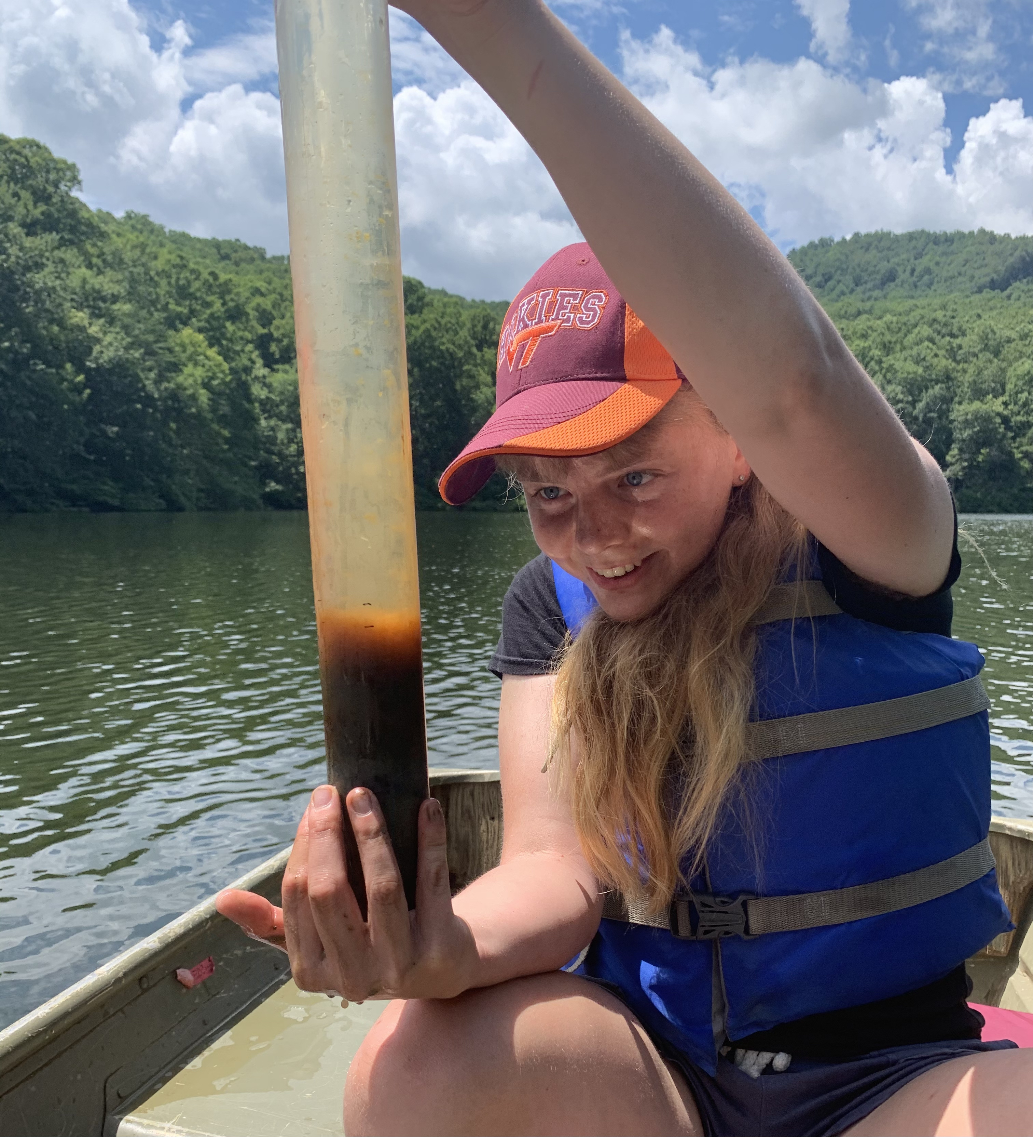
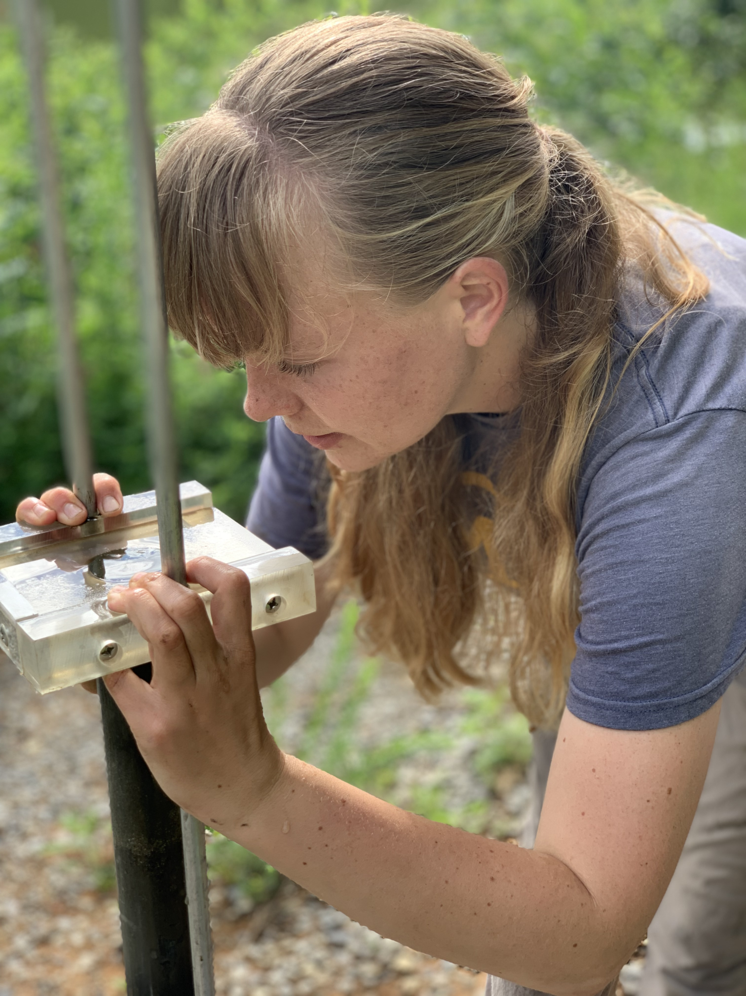
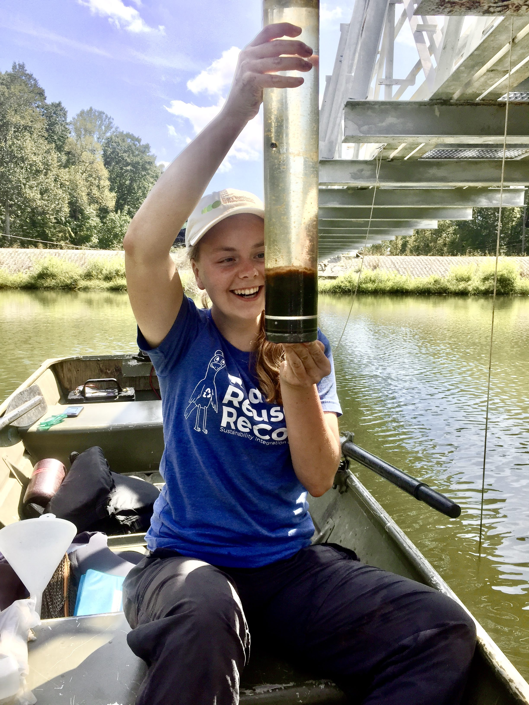
Does Fe-OC play a role in freshwater carbon burial?
Top 1cm of sediment
Sedimenting material

Slide 7
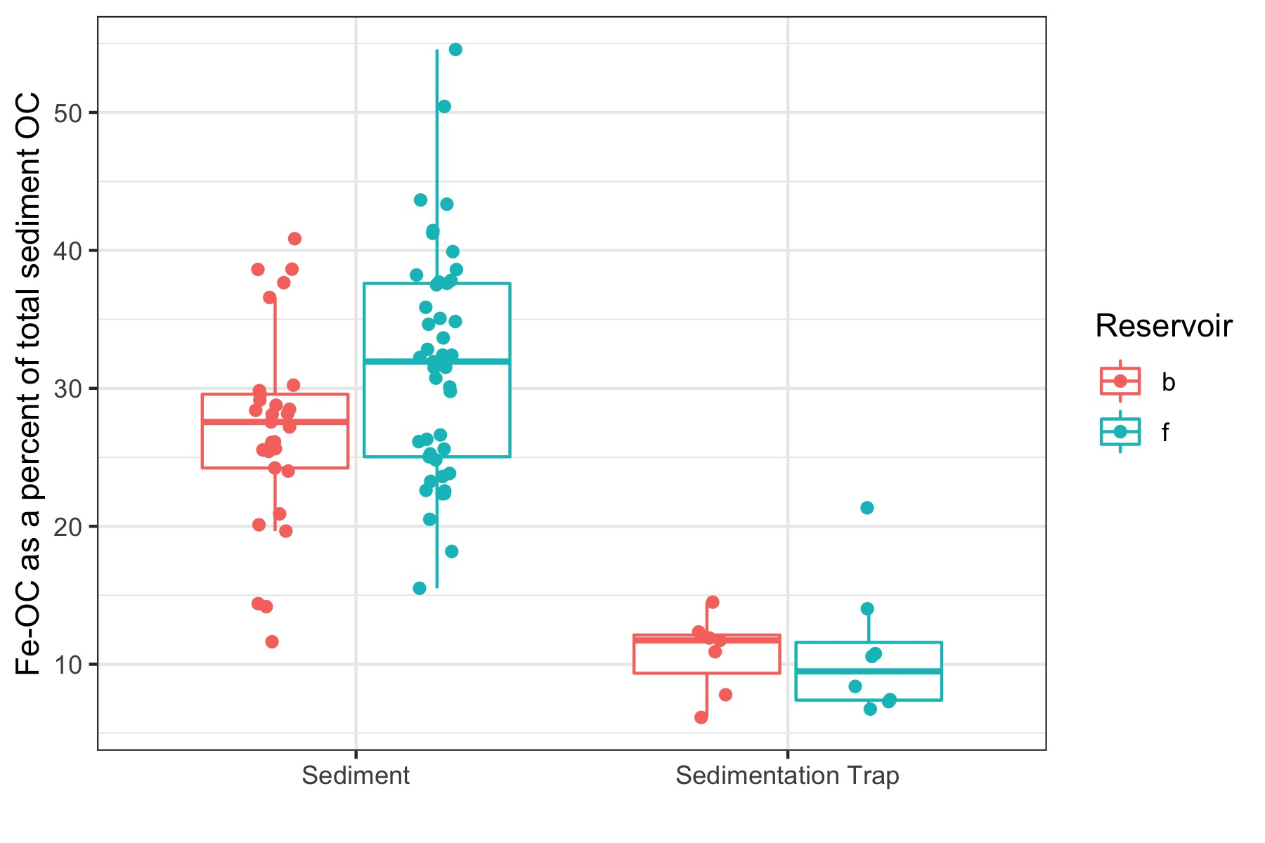
Does Fe-OC play a role in freshwater carbon burial?
Fe-OC levels in two VA reservoirs are higher than those reported for marine sediments
Ocean sediment
Fe-OC is preferentially preserved in the top centimeter of sediment
Swedish lakes

Slide 8
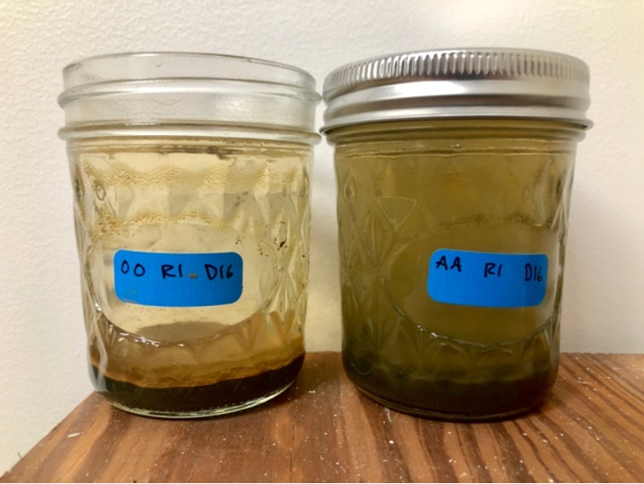
How does anoxia impact Fe-OC in freshwater sediments?

Slide 9
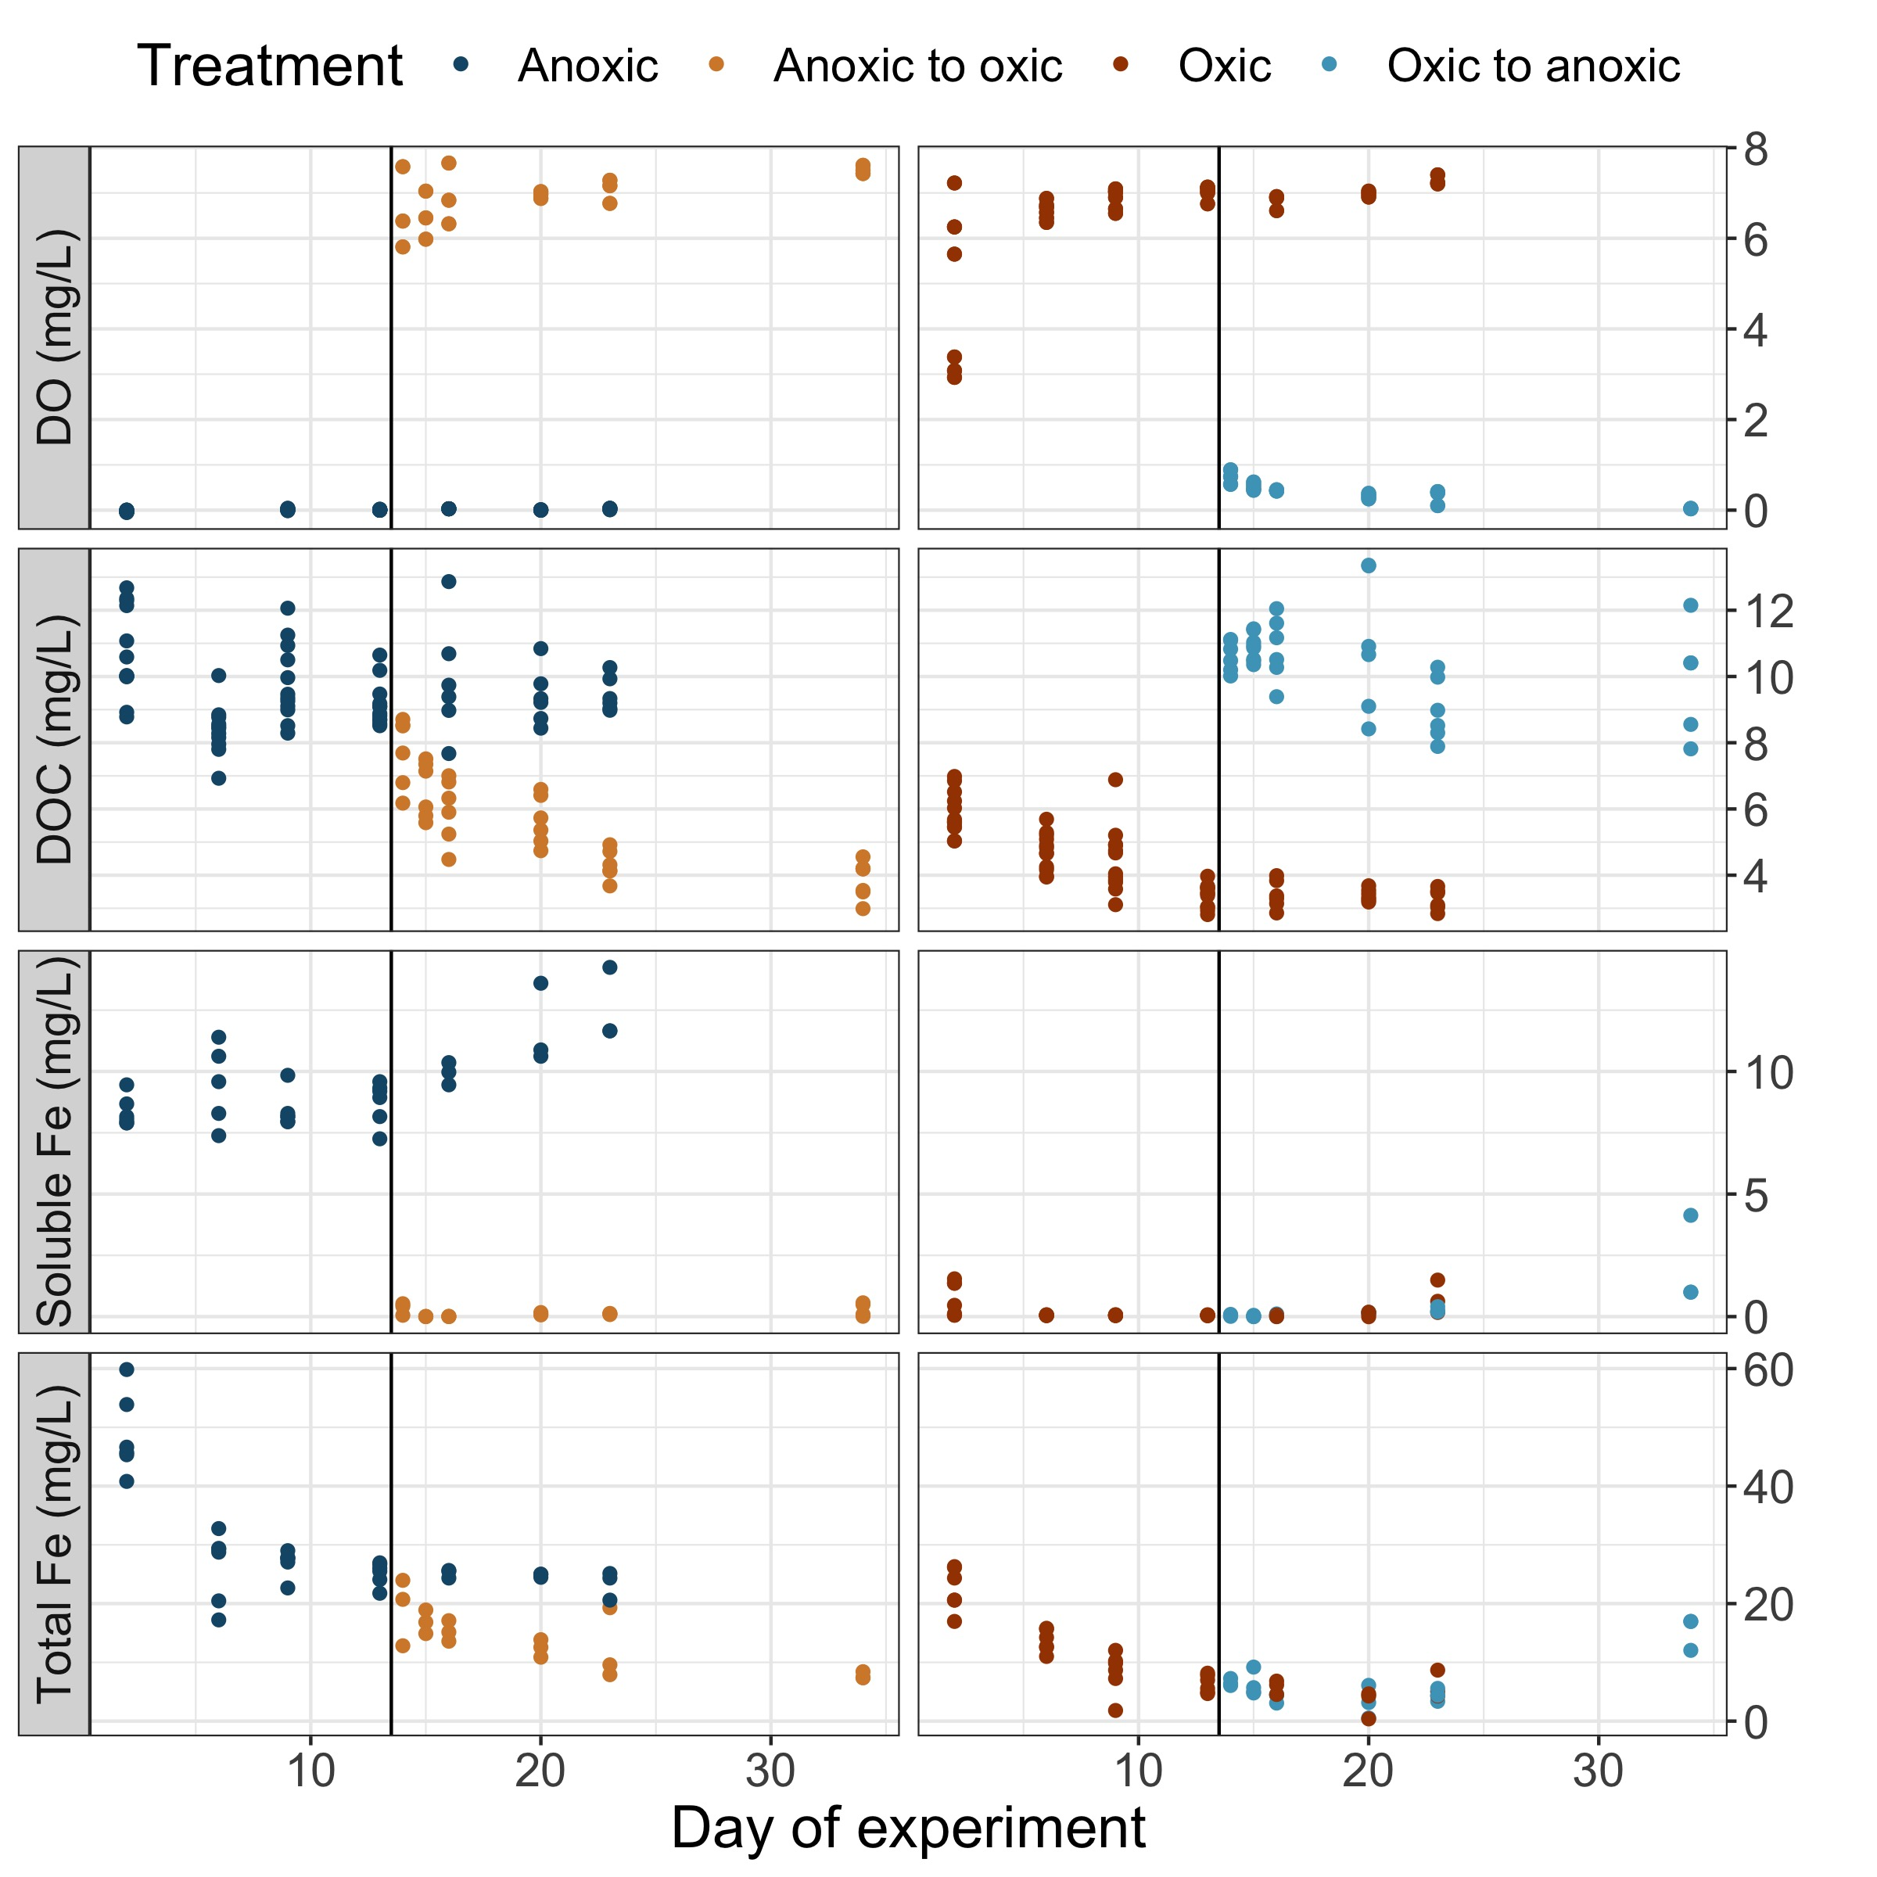
How does anoxia impact Fe-OC in freshwater sediments?

Slide 10
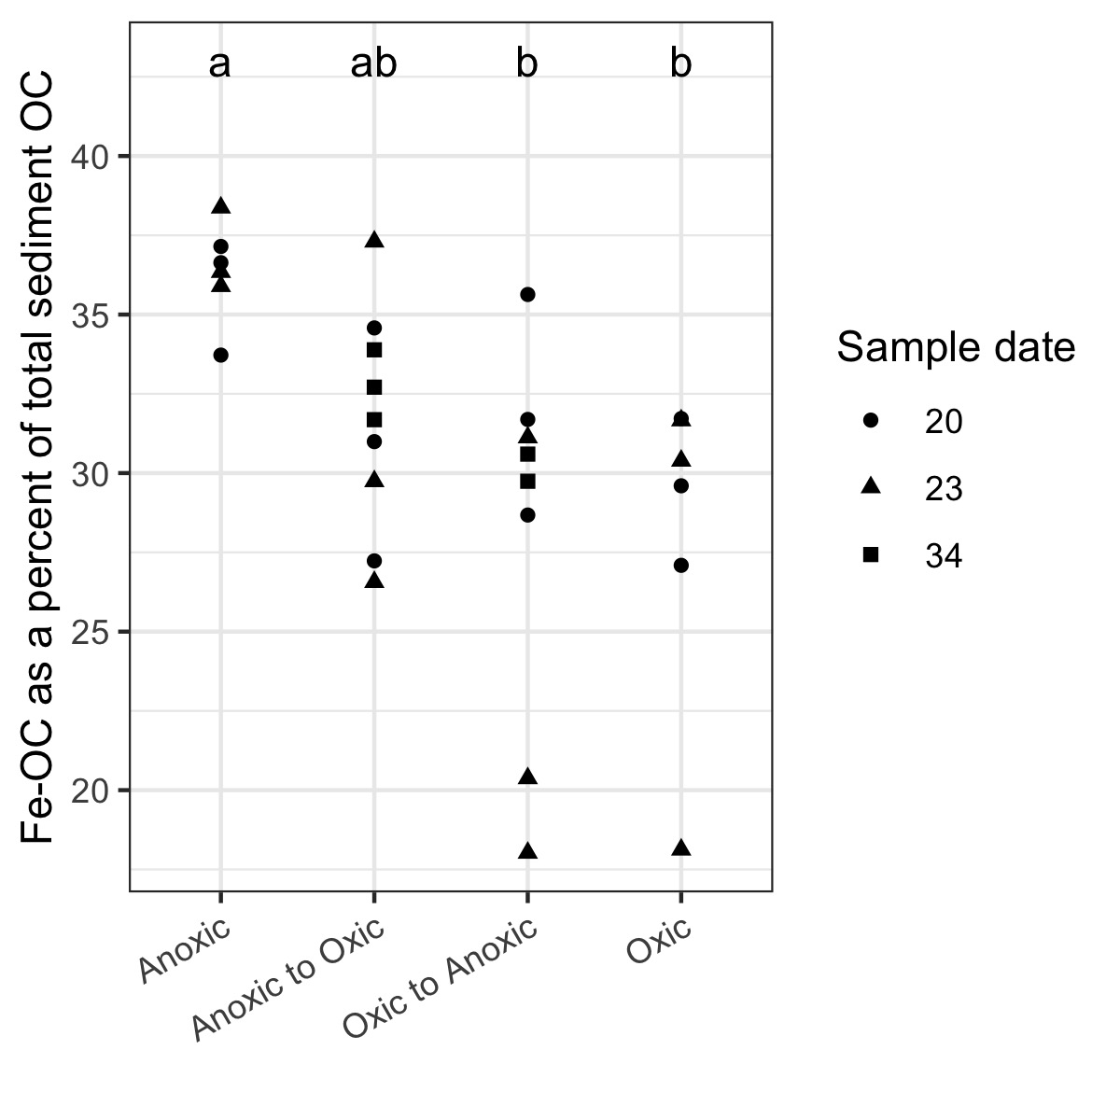
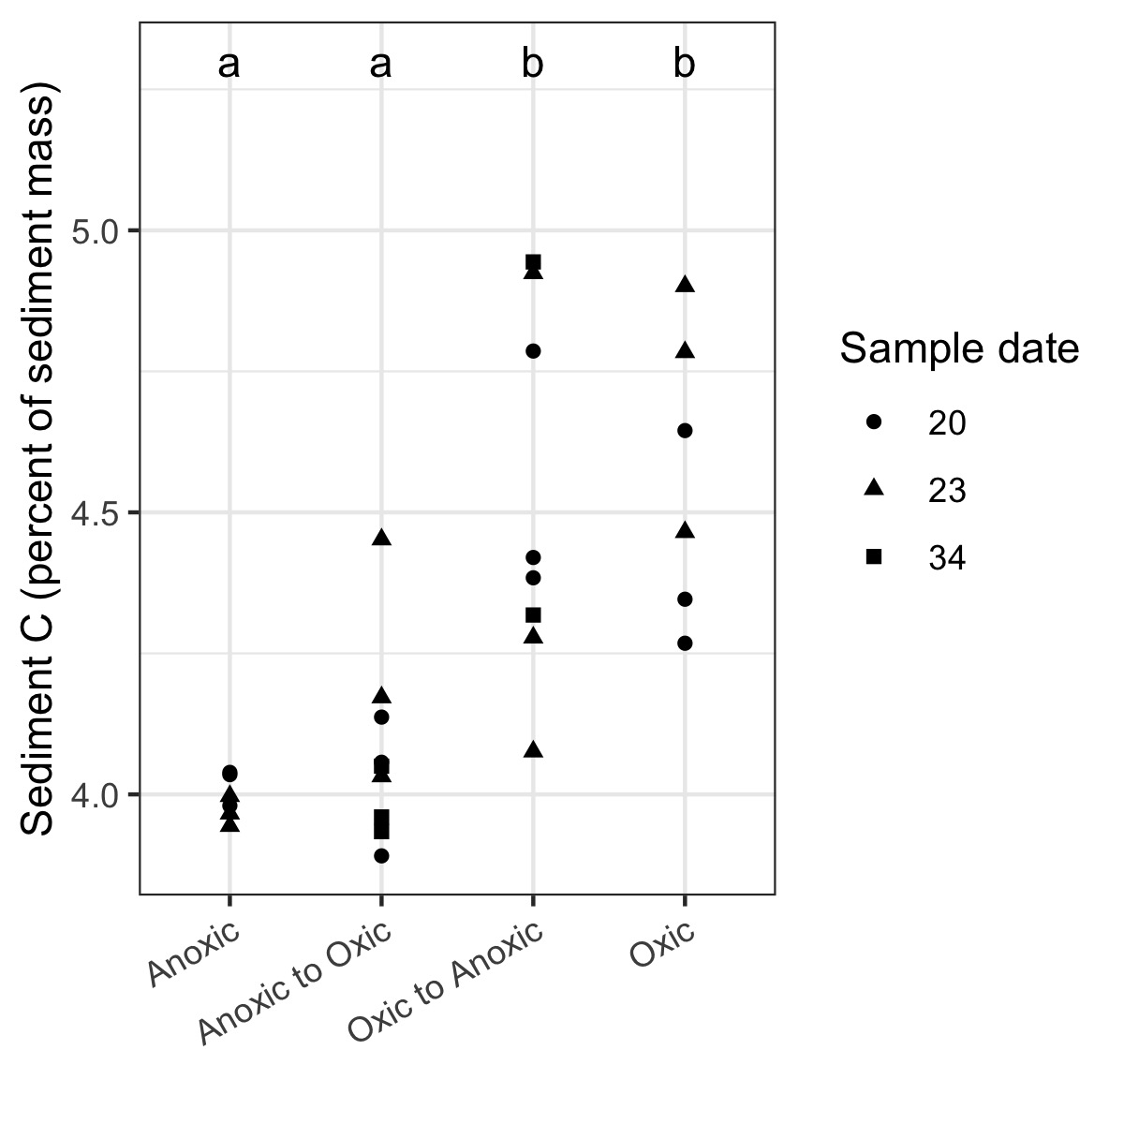
Anoxia increases the percentage of sediment OC that is bound to Fe
…by decreasing total sediment OC
Fe-OC
Fe-OC

Slide 11
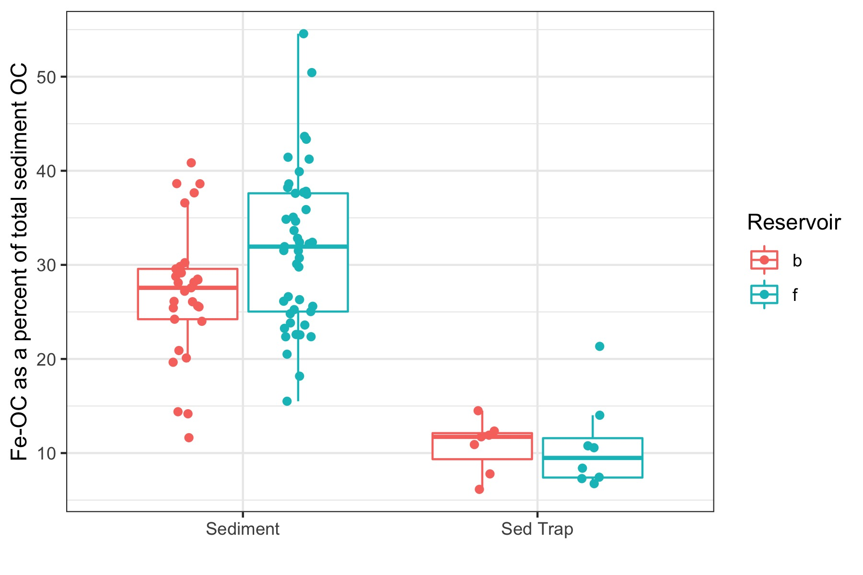
Does Fe-OC play a role in freshwater carbon burial?
Higher concentrations of Fe-OC in FCR and BVR than other lakes
Fe-OC is disproportionately preserved in sediments
How does anoxia impact Fe-OC in freshwater sediments?
Over short timescales, OC that is not bound to Fe is more sensitive to changes in redox conditions than Fe-OC

Slide 12
Huge shout out to Bobbie, Cayelan, Nick Hammond, Maddy Schreiber, and Arpita Das for all their help with this project! And to Jeb + Jeb’s lab for letting me use their lab equipment last semester! ☺

Slide 13
Questions? Or thoughts about alternative mechanisms for OC release?

